Slide 1
Phishing Website Detection System
Laiba Saleem
BITF22M043

Slide 2
Problem Statement
90% of data breaches start with phishing
Users can't identify malicious URLs instantly

Slide 3
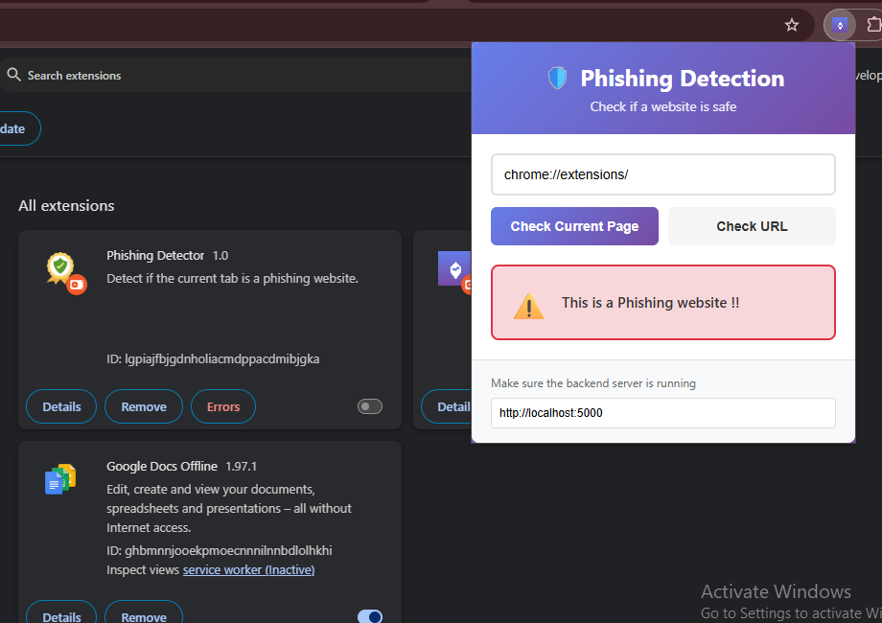
Real-time AI-powered phishing detection
Chrome extension
💡 Proposed Solution

Slide 4
Tools & Technologies
Tech
549,405 URLs (392K good, 156K phishing)
Logistic Regression
Chrome extension
We used this
DataSet
ML Model
Stack
Interfaces
Python, Flask, scikit-learn, NLTK

Slide 5
⚙️ Working Steps
The system receives a URL and performs pre-filtering to identify safe protocols and internal addresses, then cleans and tokenizes it into components. These tokens are converted into 350,000+ dimensional feature vectors and analyzed by a trained Logistic Regression model. The prediction result is instantly displayed showing either safe or phishing
1. URL Input
2. Pre-filtering
3. Tokenization
4. Feature Extractor
5. ML Prediction
6. Results

Slide 6
RESULTS & PERFORMANCE
Model Accuracy: 96.55%
Precision: 0.97 | Recall: 0.91 | F1-Score: 0.94
Prediction Speed: <100ms
Features: 350,840 URL patterns
Examples:
Safe: youtube.com, github.com
Phishing: login.alibaba.com/wp-admin/login.jsp.php

Slide 7
Demo…..

Slide 8
Thank you!
Laiba Saleem

